Slide 1

Section 7.8 Improper Integrals
Lecture 1
Unbounded Area and Exploring Infinity

Slide 2

Section 7.8 Homework Submission to Canvas
Preview of section
Skim the section in text and write a short paragraph summary.
Give a bulleted list of all important definitions, theorems, and formulas without details.
Notes on video lectures
Take notes on everything written on slides including all details, worked examples, on-own activities, as well as your own thoughts and questions.
Try on-own activities first, then write down provided solution next to it for comparison.
Worked examples from the text
Write down the problem and attempt without looking at the solution.
Use the solution to write the best explanation you can.
Solutions to textbook exercises
Model approaches and explanations given in the video lectures and textbook examples.
Final reflection of section
List the key takeaways to remember as a bulleted list.

Slide 3
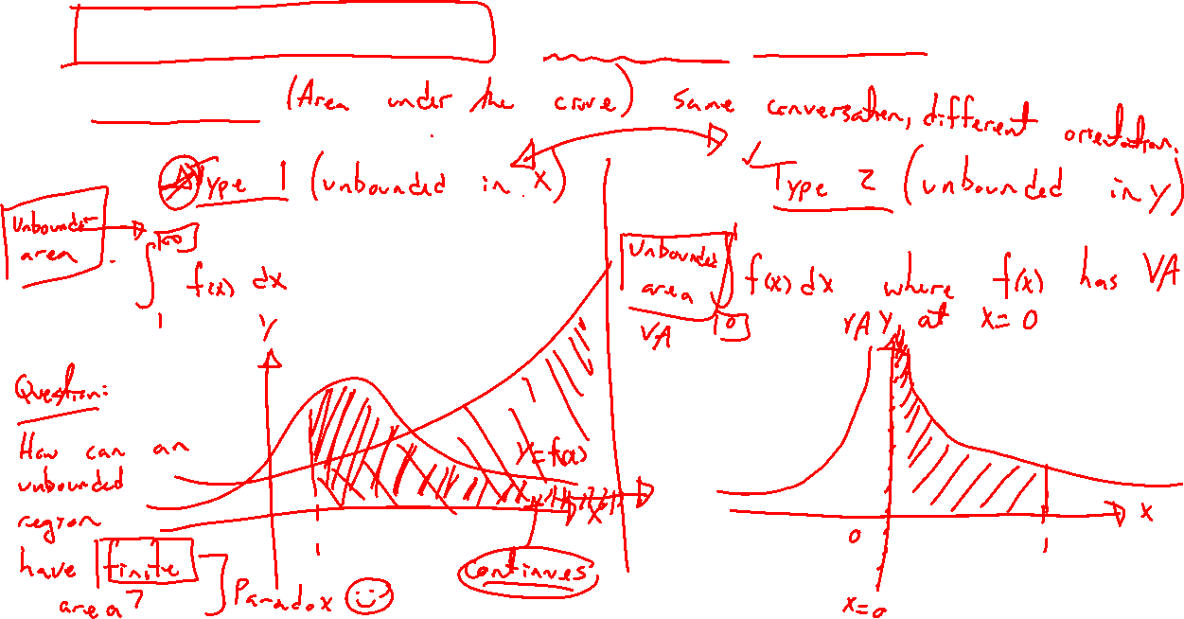
Improper Integrals: Extending Definite Integrals
Notes:
2 cases:
\int_1^\infty 1/x ~dx
\int_0^1 1/x ~dx
Why bother? How to make sense of it?

Slide 4
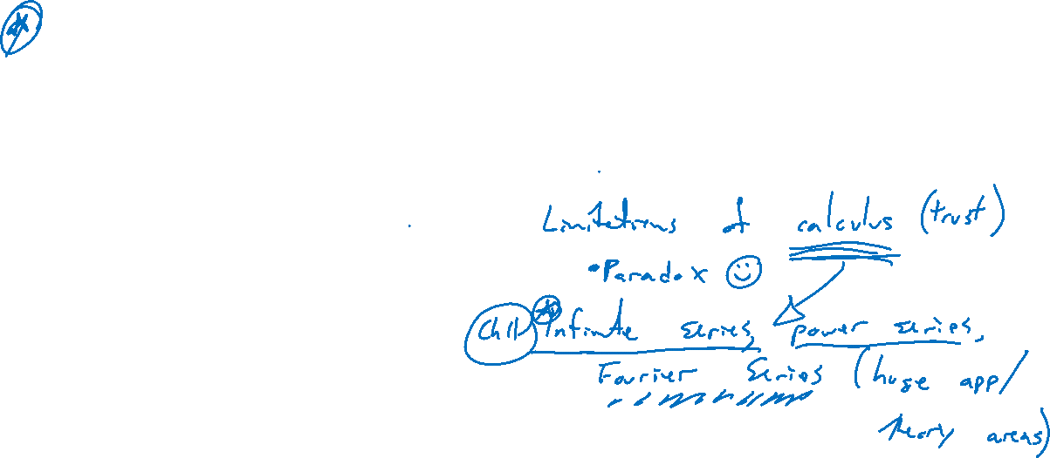
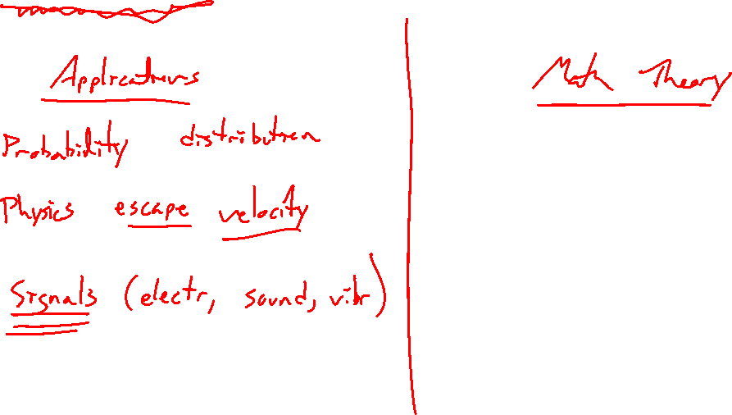
Why Bother? Applications and Understanding
Notes:
Probability: Bell curve and normal distributions (https://en.wikipedia.org/wiki/Normal_ distribution)
Physics: Escape velocity (https://en.wikipedia.org/wiki/Escape_velocity)
Study the nuances of infinity
Find the limitations of the Riemann integral (https://en.wikipedia.org/wiki/Lebesgue_ integration#Intuitive_interpretation, en.wikipedia.org/wiki/Henri_Lebesgue#Lebesgue’ s_theory_of_integration) as discovered in 1900s thru studying probability / Fourier series / transform. Fourier: https://en.wikipedia.org/wiki/Fourier_series
Orbitness: https://www.youtube.com/watch?v=QVuU2YCwHjw

Slide 5
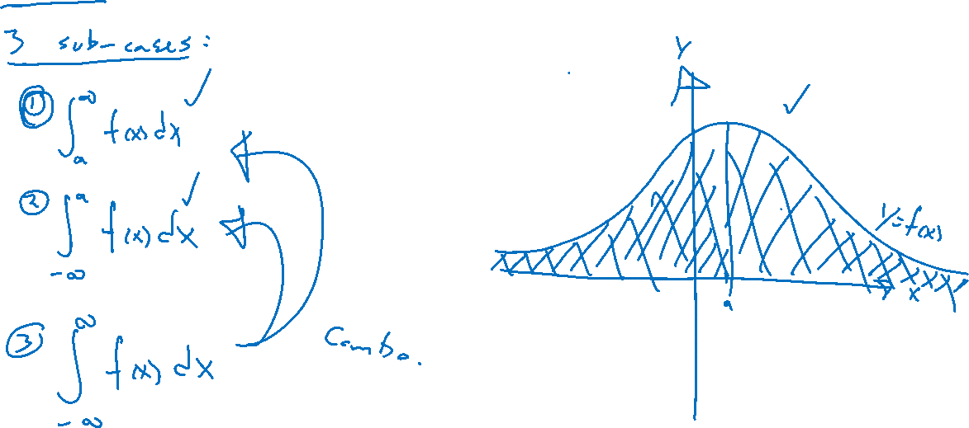
Case 1: Unbounded in x
Notes:
Draw pictures, need f(x) to decay to zero for hope of finite area
\int_a^\infty f(x) ~dx
\int_{-\infty}^a f(x) ~dx
\int_{-\infty}^\infty f(x) ~dx

Slide 6
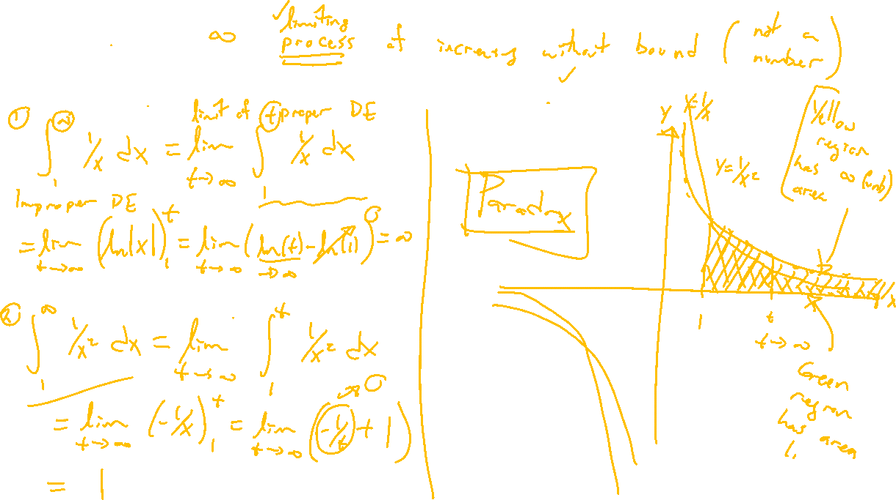
Computing Improper Integrals
Notes:
Examples: Substuting infinity doesn’t make sense
\int_1^\infty 1/x ~dx
\int_1^\infty 1/x^2 ~dx
Limit lets us compute, rate of decay is key

Slide 7
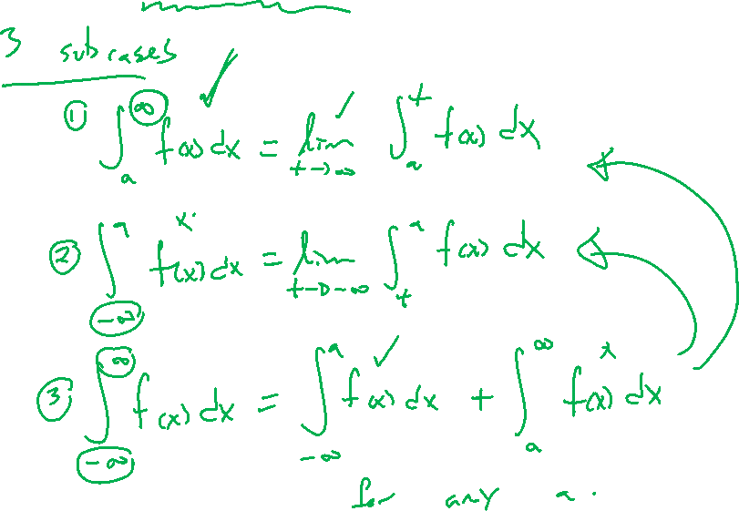
Case 1 Definitions: Unbounded in x
Notes:
Careful limit definitions of each, draw pictures
\int_a^\infty f(x) ~dx
\int_{-\infty}^a f(x) ~dx
\int_{-\infty}^\infty f(x) ~dx, need both limits to exist to separate

